Slide 1
Search and optimization
Artificial Intelligence Assignment - 2
Sandeep Kumar (CS24M112) Abhishek Kumar (CS24M120)

Slide 2
Environment, Heuristic and Metrics
Heuristics Used: ○ Frozen Lake : Manhattan Distance to goal ○ TSP: Total path cost from permutation of cities
Environments: ○ FrozenLake : For BnB & IDA* ○ gym_TSP: For HC & SA
Evaluation Metrics: ○ Reward = -1 * Distance/Steps ○ Time (sec) ○ Convergence Point (iterations)

Slide 3
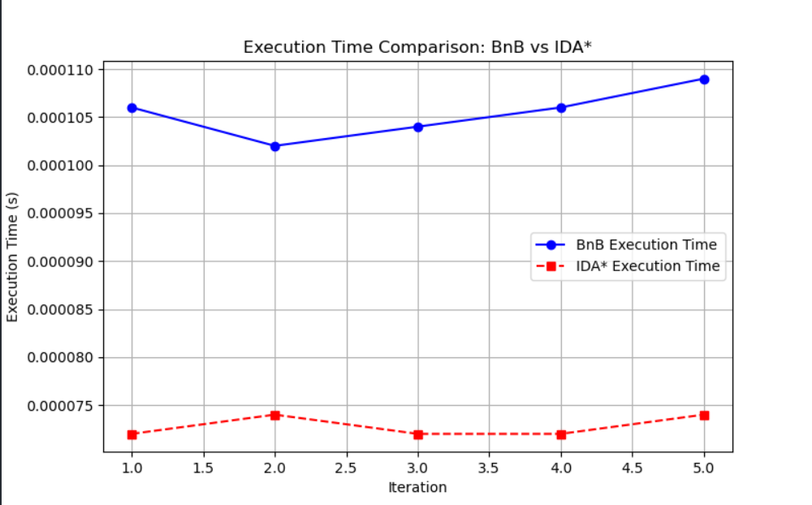
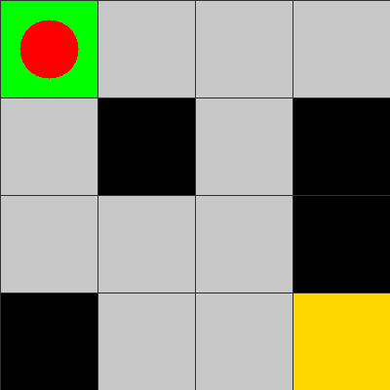
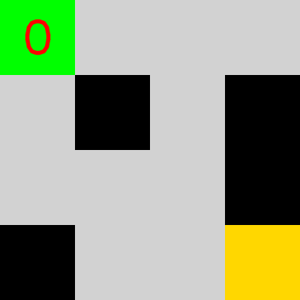
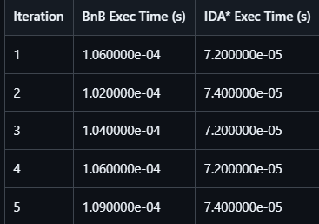
Frozen Lake
Using BnB
Using IDA*
Time Comparison for Five Iteration

Slide 4
Frozen Lake (Observation)
Branch and Bound (BnB) generally exhibits slightly higher average execution time, primarily influenced by an occasional outlier run. This is expected, as BnB maintains an explicit search tree in memory, making it memory-intensive, especially for deeper or more complex environments.Environments.
Iterative Deepening A* (IDA*) shows faster and more consistent performance across runs. Its depth-first nature allows it to use significantly less memory, as it avoids storing the full tree in memory, instead exploring one path at a time with iterative cost thresholds.
Overall, IDA* proves more efficient and scalable for the Frozen Lake problem, especially in constrained memory environments.

Slide 5
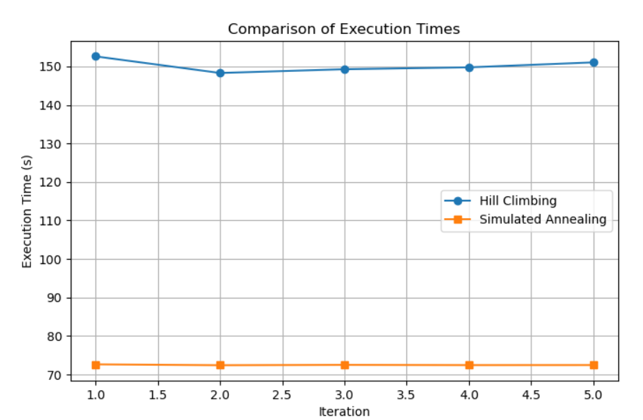
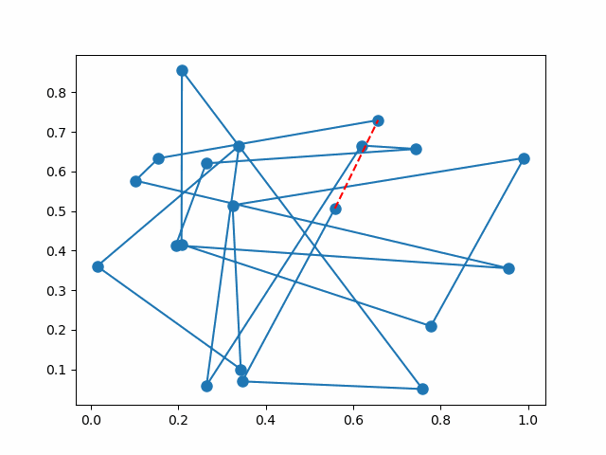
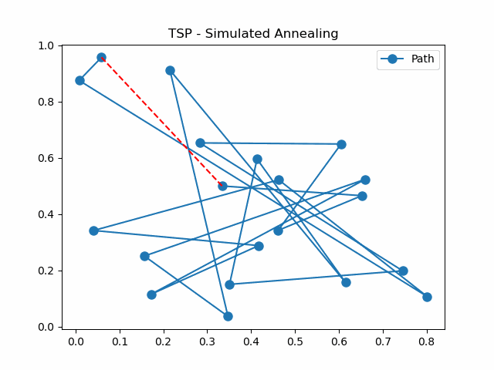
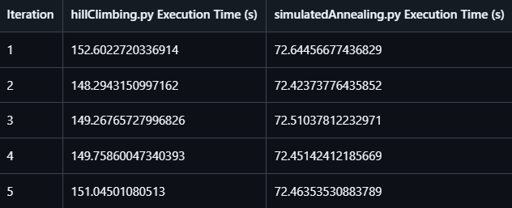
TSP
Using Hill Climbing
Using Simulated annealing
Time Comparison for Five Iteration

Slide 6
TSP (Observation)
Hill Climbing (HC) is generally faster, but its greedy nature makes it prone to getting stuck in local minima. Although restarts are used to overcome this, they can increase overall runtime and still may not escape poor-quality solutions.Overall, IDA* proves more efficient and scalable for the Frozen Lake problem, especially in constrained memory environments.
Simulated Annealing (SA) is typically slower due to its exploratory behavior and probabilistic acceptance of worse solutions. However, this enables it to avoid premature convergence and explore the solution space more thoroughly.
Tradeoff: While HC converges quickly, it often settles for suboptimal solutions. In contrast, SA requires more time but tends to discover higher-quality tours, making it more reliable for complex instances of TSP.

